Slide 1
Particle Pals: Technology Review
Carlos Abarca, Julio Chavez, Chandler Heintz, Mohan Kukreja, Rui Yan

Slide 2
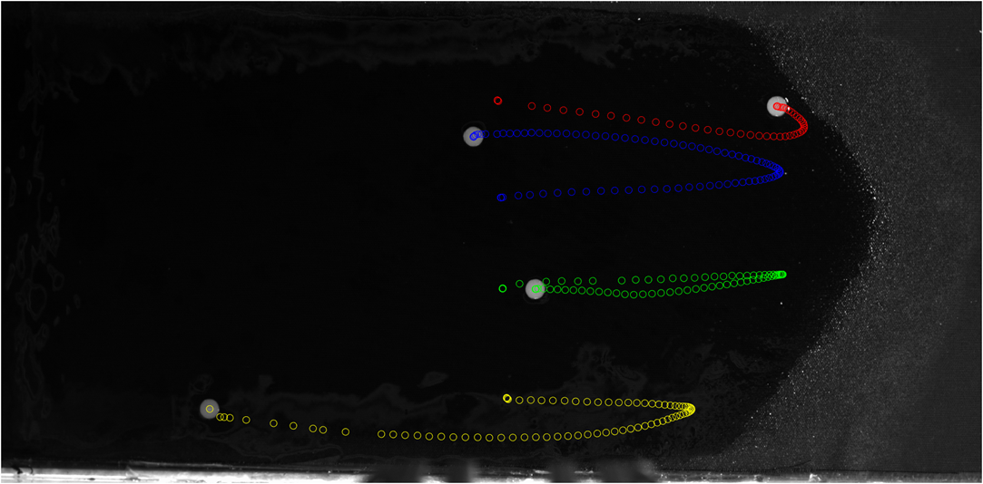
Background
Project Goals:
Create GUI that will allow users to track particles/objects
Proper storage and organization for data
Why a GUI?
We want to create an easy-to-use interface
Users can be inexperienced/new to particle tracking
Should be versatile
If users have experience, they should be able to use it

Slide 3

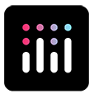


Technologies Considered
Streamlit
Plotly Dash
PyTK
PyQt5
Notes:
Streamlit: Open source library for building gui dashboards or multi-page web apps, geared towards data science
Plotly Dash: same idea as streamlit – but also has an enterprise version with more features
Pytk: uses tkinter binding for tk widget library with an extra layer of python abstraction for easier use
PyQt5: set of bindings for Qt v5 app framework

Slide 4
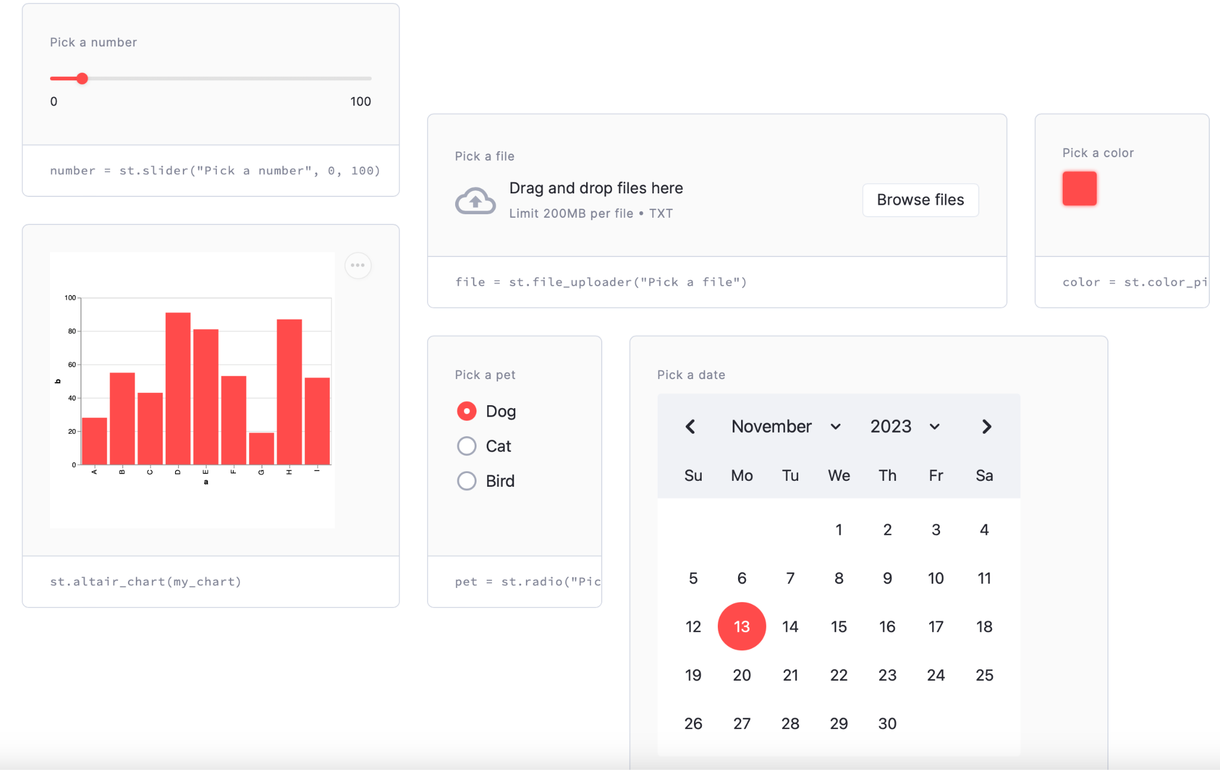
Why Streamlit
Easy to use
Open access
Works well with Pandas, Matplolib
Widgets for different data types.

Slide 5
Appeal of Streamlit
Nels is an expert (#respectthehoodie)
Streamlit is designed with simplicity in mind. Even those with limited experience in web development can create interactive, data-driven web apps.
Streamlit doesn't require in-depth knowledge of front-end technologies like HTML, CSS, or JavaScript. (None of us are good in CSS)
Streamlit includes widgets like sliders, buttons, and text input, which make it straightforward to build interactive features into apps.

Slide 6
Drawbacks of Streamlit
Not very customizable for projects that have a lot of components.
Only works on the web
May be slow for large data sets???
Streamlit is Python-centric, which is great for Python users but excludes those who prefer or require other programming languages.
Some components might need to be written in another language for efficiency.

